Slide 1

Objectives
In this session, you will learn to:
    Work with views
    Work with models

Slide 2
Recap
Which symbol is used to distinguish the server-side code from the markup code in Razor?
Which is the first method that is invoked when an MVC application starts?
Which method has the definition of the default route?
What is the name of the controller and action method in the URL,” http://www.giftgallery.com/gift/Create” ?
Which method adds a special route and tells the routing engine to ignore requests for any URL that matches the given pattern?

Slide 3
Passing Data from a Controller to a View
The following two common techniques are used to pass data from a controller to a view:
    ViewData:
      Is a dictionary of objects derived from the ViewDataDictionary class.
      Uses key/value pairs in the controller action method to set values, as shown in the following code snippet:
ViewData["Message"] = "Welcome to our website";
ViewData["ServerTime"] = DateTime.Now;
      Allows to access the added values in a view by using the Razor syntax, as shown in the following code snippet:
<p>
The message is: @ViewData["Message"]
The Date and Time is: @ViewData["ServerTime"]
</p>

Slide 4
Passing Data from a Controller to a View (Contd.)
    ViewBag:
      Allows to add properties of multiple types and their values in a controller action method as shown in the following code snippet:
ViewBag.Message = "Welcome to our website";
ViewBag.ServerTime = DateTime.Now;
      Allows to access the added values in a view as shown in the following code snippet:
<p>
The message is: @ViewBag.Message
The Date and Time is: @ViewBag.ServerTime
</p>
      Works only in those cases where the key being accessed is a valid C#
      identifier.

Slide 5
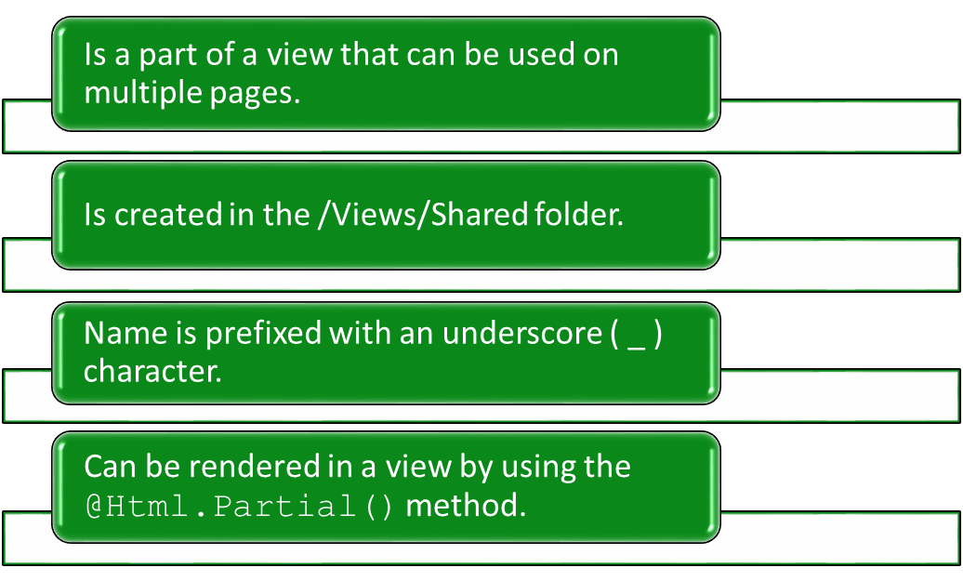
Using Partial Views
A partial view:

Slide 6
Using Partial Views (Contd.)
The following code snippet renders a partial view named _partialsummary within a view:
    <div>@Html.Partial(“_partialsummary”)</div>
Let us see how to create a partial view

Slide 7
Just a Minute
Which one of the following options is used to pass information from a controller to a view in an ASP.NET MVC application?
    Caching
    Routing
    ViewData

Slide 8
Just a Minute (Contd.)
Solution:
    ViewData

Slide 9
Demo: Passing Data Between Controllers and Views (Contd.)
    Instead of making the change in each individual view, you decide to create a partial view to render the content of the right pane.
    Prerequisite: To perform this activity, you need the LG_02_Activity_02.zip, UpcomingMovies_ActionMethod.txt, and UpcomingMovies.txt files.

Slide 10
Demo: Passing Data Between Controllers and Views (Contd.)
Solution:
    To solve the preceding problem, you need to perform the following tasks:
      Create an action method within the Home controller.
      Create the Upcoming Movies view.
      Create a partial view.
      Render a partial view in the Home page.
      Render a partial view in the About Us page.
      Render a partial view in the Contact Us page.
      Render a partial view in the Upcoming Movies page.
      Execute the application.

Slide 11
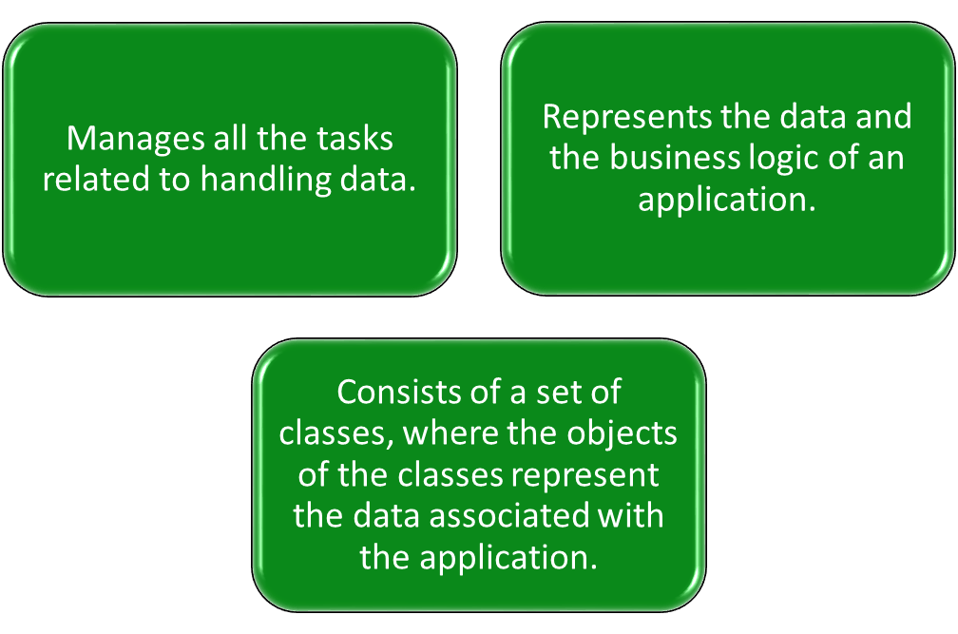
Working with Models
A model:

Slide 12
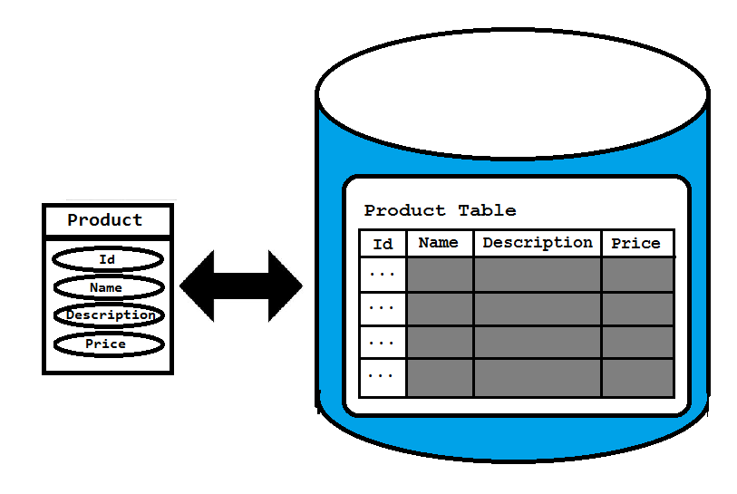
Working with Models (Contd.)
Suppose you have the data of products, which includes product name, description, and price.
To represent this data, you need to create a model class named Product with properties, such as Id, name, description, and price.
The structure of the model class should be similar to the structure of the Product table in the database as shown in the following figure.

Slide 13
Working with Models (Contd.)
The direct mapping between the properties of the Product class and
the fields of the Product table is called object-relational mapping.

Slide 14
Creating a Model
Suppose you need to add a class in the model that defines the properties of the product, such as Id, product name, description, and price.
The following code snippet declares the model class:
public class Product
{
public long Id {get; set;}
public string name {get; set;}
public string description {get; set;}
public int price {get; set;}
}
All model classes are stored in the Models folder within an ASP.NET MVC application.
Let us see how to create a model

Slide 15
Accessing a Model Within a Controller
You need to create an object of the model class in the Product action method, as shown in the following code snippet:
public ActionResult Product()
{
var product = new Newbay.Models.Product();
product.name = "Samsung 5676 Mobile";
product.description = "Newly launched with touch screen";
product.price = 15000;
return View();
}
To refer to the Product model class, the qualifier, Newbay.Models, is used.
This qualifier can be omitted by including the namespace, Newbay.Models, at the top of the controller class, as shown in the following code snippet:
using Newbay.Models

Slide 16
Accessing a Model Within a Controller (Contd.)

Slide 17
Passing Model Data from a Controller to a View
Model data needs to be made accessible to a view so that it can be displayed to the users.
For this, the controller can pass the model data to the view at the time of invoking the view.
Single object
Model data
Collection of objects

Slide 18
Passing Model Data from a Controller to a View (Contd.)
You can pass the model data from a controller to a view by using ViewBag.
  Example:
    public ActionResult Product(){
    var product = new Product();
    product.name = "Samsung 5676 Mobile";
    product.price = 15000;
    ViewBag.product = product;
    return View();
    }
    You can access the passed data on the corresponding view with the help of ViewBag, as shown in the following code snippet:
    @ViewBag.product.name<br/>
    @ViewBag.product.price<br/>

Slide 19
Passing Model Data from a Controller to a View (Contd.)
    Alternatively, you can pass the data to a view by passing the object as a parameter to the view, as shown in the following code snippet:
    public ActionResult Product()
    {
    var product = new Product();
    product.name = "Samsung 5676 Mobile";
    product.price = 15000;
    return View(product);
    }
    When you pass data object as a parameter to the view, you can use @Model to access the passed data on corresponding view.
    Example:
    @Model.name <br/>
    @Model.price <br/>

Slide 20
Passing Model Data from a Controller to a View (Contd.)
Similar to a single object, you can pass a collection of objects from a controller to a view by using ViewBag.
Example:
public ActionResult Productlist()
{
var products = new List<Product>();
var product1 = new Product();
product1.name = "Samsung 5676 Mobile";
product1.price = 15000;
var product2 = new Product();
product2.name = "Dell Inspiron 1545 laptop";
product2.price = 40000;
products.Add(product1);
products.Add(product2);
ViewBag.products = products;
return View();
}

Slide 21
Passing Model Data from a Controller to a View (Contd.)
To access the passed data on corresponding view, you need to iterate through the collection of objects stored in ViewBag.
Example:
@{
var products = ViewBag.products;
}
@foreach (var p in products)
{
@p.name<br />
@p.price<br />
<br />
}

Slide 22
Passing Model Data from a Controller to a View (Contd.)
Alternatively, you can pass the data to a view by passing a collection of objects as a parameter to the view.
Example:
public ActionResult Productlist()
{
var products = new List<Product>();
var product1 = new Product();
product1.name = "Samsung 5676 Mobile";
product1.price = 15000;
var product2 = new Product();
product2.name = "Dell Inspiron 1545 laptop";
product2.price = 40000;
products.Add(product1);
products.Add(product2);
      return View(products);
}

Slide 23
Passing Model Data from a Controller to a View (Contd.)
When you pass collection of objects as a parameter to the view, you can use model to access the passed data on corresponding view.
Example:
@{
var products = Model;
}
@foreach(var p in products)
{
@p.name <br />
@p.price <br />
<br/>
}

Slide 24
Passing Model Data from a Controller to a View (Contd.)
Let us see how to pass model data from a controller to a view

Slide 25
Summary
In this session, you learned that:
    The following two common techniques are used to pass data from a controller to a view:
      ViewData
      ViewBag
    ViewData is a dictionary of objects derived from the ViewDataDictionary class.
    ViewBag is just a dynamic wrapper over the ViewData dictionary.
    A partial view is a part of a view that can be used on multiple pages.
    You can render a partial view in a view by using the @Html.Partial() method.
    In an MVC application, the component that enables interaction with data is called model.
    A model consists of a set of classes, where the objects of the classes represent the data associated with the application.

